Slide 1
Parameterized Workload Adaptation for Fork-Join Tasks with Dynamic Workloads and Deadlines
Marion Sudvarg, Jeremy Buhler, Roger Chamberlain, Chris Gill
Computer Science and Engineering
Washington University in St. Louis
James Buckley
Department of Physics
Washington University in St. Louis
Wenlei Chen
School of Physics and Astronomy
University of Minnesota
RTCSA 2023
Niigata, Japan
This research was supported in part by NSF grants CSR-1814739, CNS-1763503, CNS-2229290 (CPS), and NASA grant 80NSSC21K1741.

Slide 2

In dynamic environments, task workloads and deadlines may not be known prior to job release
May result in system overload – jobs unable to meet deadlines
Adjust computational parameters to provide an imprecise result prior to the deadline
Anytime workloads
Select from a discrete set of computational modes

Slide 3
But … these semantics may not fully capture the dimensions over which a task’s workload can adapt to meet its deadline
Computations may have multiple parameterized degrees of freedom (categorical, discrete numeric, continuous numeric)
Given an allocation of resources to a task …
How do we adjust its computational workload to minimize degradation of result utility
While remaining within the dynamic constraints of schedulability?

Slide 4
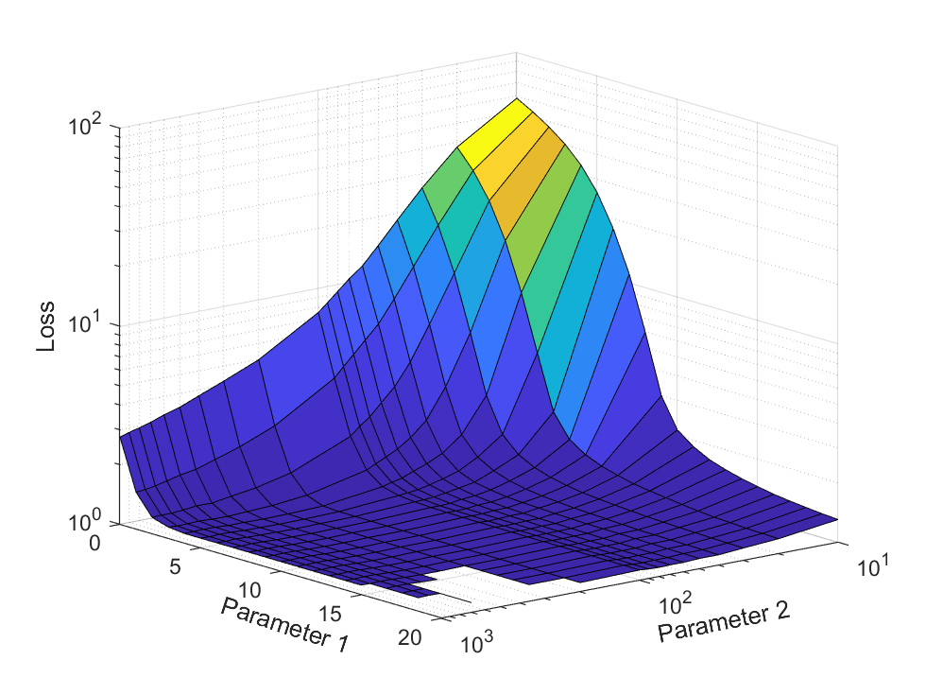
How do we adapt to minimize loss within schedulability constraints?
Identify parameterized degrees of freedom over which computational workload may be compressed
Characterize loss over parameter space
Characterize worst-case response times
Reduce parameter space to Pareto-optimal surface
Online: search for best set of parameters satisfying constraints

Slide 5
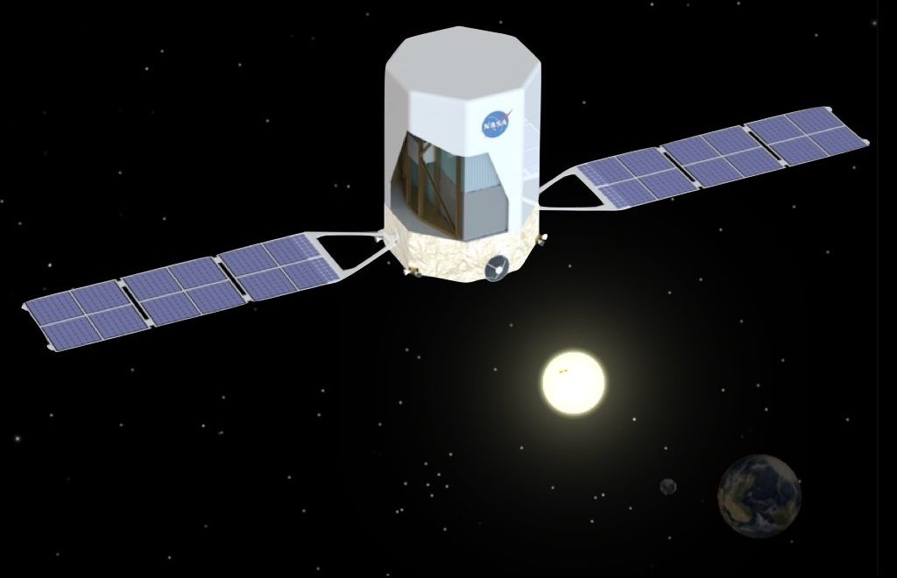
The Advanced Particle-astrophysics Telescope (APT)
Motivating Example

Slide 6

Real-Time Gamma-Ray Burst (GRB) Localization
GRBs are rapid, immense bursts of energy
We are developing a satellite telescope to detect and localize GRBs in real-time
Will enable secondary instruments to immediately point at the burst
Algorithms will run on embedded hardware onboard the satellite
Image courtesy NASA, ESA and M. Kornmesser (https://www.nasa.gov/feature/goddard/2019/hubble-studies-gamma-ray-burst-with-highest-energy-ever-seen)

Slide 7
Challenge: Dynamic Workloads and Deadlines
Every GRB is unique!
Brightness
(10³ – 10⁶ incident gamma rays)
Spectral energy distributions
Initial burst durations
(10 milliseconds – 20 minutes)
Workload depends on
The number of gamma rays entering the detector
Their physical interactions with the detector
Deadline may depend on
The duration of the burst
Availability of follow-up instruments
Not known prior to burst arrival!
How can we adapt and compress the computational pipeline to maximize localization accuracy even for bright transients while guaranteeing short deadlines?

Slide 8
Adapt to Minimize Loss within Schedulability Constraints
Identify parameterized degrees of freedom over which computational workload may be compressed
Event Reconstruction
Source Approximation
Iterative Refinement
Number of gamma-rays selected for reconstruction
Technique
Sample Size
Number of Iterations

Slide 9
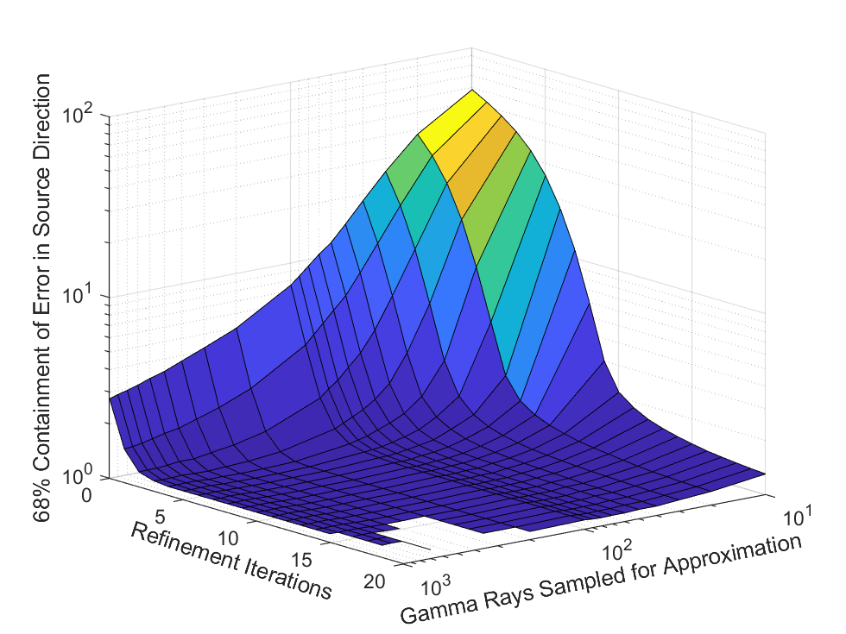
Adapt to Minimize Loss within Schedulability Constraints
Characterize loss (due to compression) over parameter space
Expected 68% confidence in GRB localization error

Slide 10
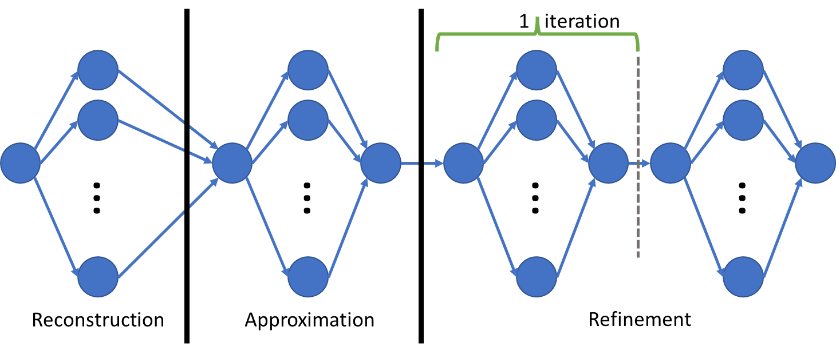
Adapt to Minimize Loss within Schedulability Constraints
Characterize worst-case response times (WCRT)
Linear In
Linear In
Quadratic In
Multiplied By
With constants defined by
Highly Parallelizable Fork-Join
Number of gamma-rays selected for reconstruction
Technique
Sample Size
Number of Iterations

Slide 11
Adapt to Minimize Loss within Schedulability Constraints
Reduce parameter space to Pareto-optimal subset
Sort parameter space by WCRT
Reduce to subset of candidate parameter space where loss decreases as WCRT increases
2657
initial candidate parameter sets
~80
parameter sets in Pareto-optimal subset

Slide 12
Adapt to Minimize Loss within Schedulability Constraints
Online: search for best set of parameters satisfying the dynamic constraints
Binary search over Pareto-optimal parameter subspace to find best parameter set with WCRT not exceeding deadline
Interpolate or extrapolate over parameter + WCRT surface to find Pareto-optimal parameters with WCRT equal to deadline

Slide 13
Results and Conclusions
Simulated 4 known short, bright GRBs
Worst-case response time on flight computer:
200ms – 1.3s
Imposed 33ms deadline:
Localized to within 1 degree!
Offline parameter and loss characterization allows for fast online workload adaptation for GRB localization!
This approach extends to other dynamic fork-join workloads with loss functions that are difficult to characterize in closed form.
Slack reclamation and OpenMP implementation tricks discussed in paper.

Slide 14


Thank You!
Any Questions?

Slide 15
Methods for Utilization Compression
Increase task period: U=C/T
  Straightforward when D=T (implicit-deadline)
  What if D is fixed (constrained-deadline)?
Decrease task workload
  How can we adapt task computation while minimizing the impact on result quality?
  Pareto-Optimization

Slide 16

2. Characterize Loss over Parameter Space
APT: expected 68% confidence in GRB localization error
Loss may not be easily fit to closed-form function of compressible parameters
Use union of half spaces, constrained by parameter bounds

Slide 17
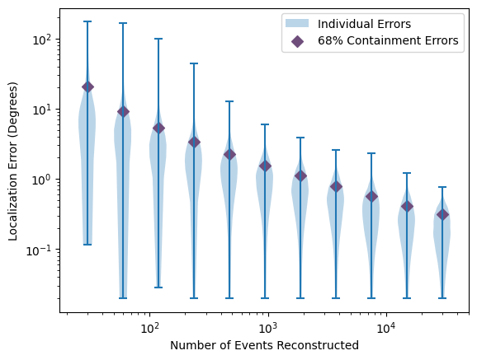
Localization Accuracy By Events Reconstructed

Slide 18
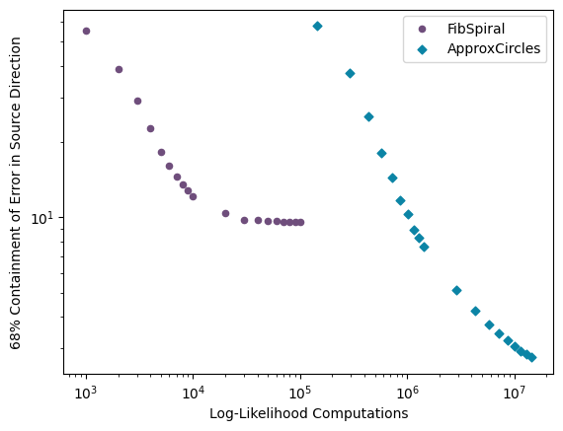
Approximation Accuracy vs Computation

Slide 19
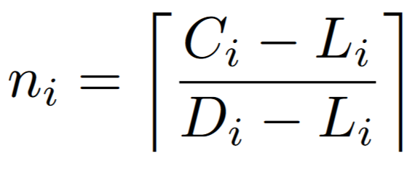
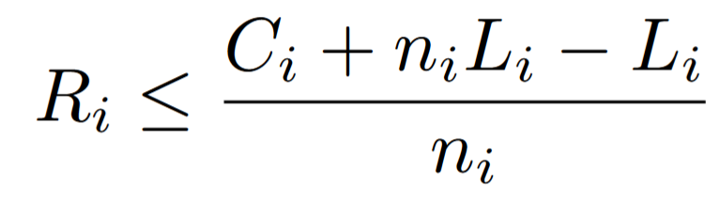
3. Characterize Worst-Case Response Times
Determine subtask WCETs as function of input parameters
Use these to upper-bound task response time given allocated cores at each tested point in parameter space
We can be less pessimistic!

Slide 20
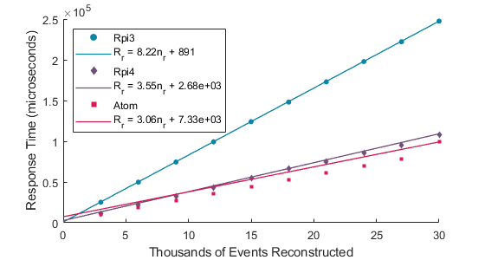
Event Reconstruction Response Times

Slide 21
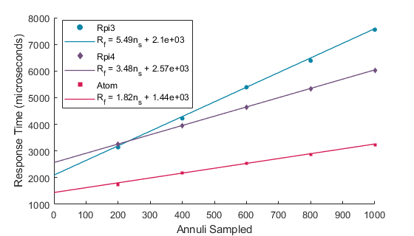
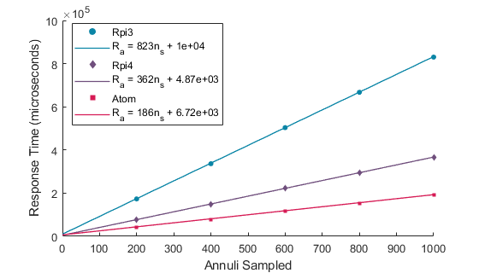
Approximation Response Times
FibSpiral
ApproxCircles

Slide 22
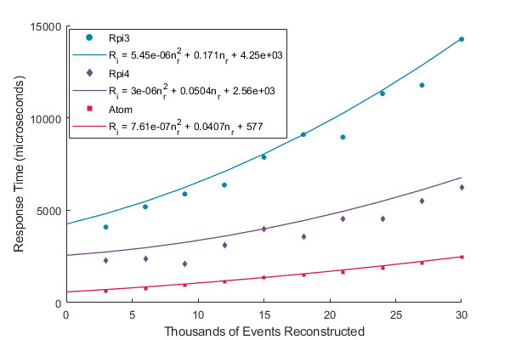
Refinement Response Times

Slide 23
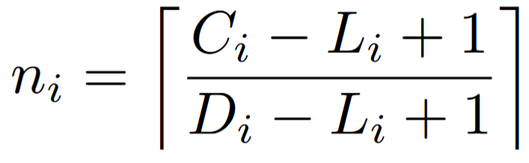
Improved Processor Assignment
If C, L, and D all integers,
Heuristics based on DAG structure (critical path and workload rooted from each node) often optimal
Express processor assignment as subgraph isomorphism, often feasible to solve with Glasgow Subgraph Solver
Find minimum core assignment for given deadline
Dual
Upper bound response time for given core assignment
M. Sudvarg and C. Gill. “Analysis of Federated Scheduling for Integer-Valued Workloads.” RTNS 2022.

Slide 24
4. Online Pareto-Optimal Compression
Sort parameter space by response time
Produce Pareto-optimal candidate set – loss monotonically decreasing as function of response time
  APT: reduces state space cardinality from 2657 to ~80
Given a dynamic workload and deadline online, find minimum candidate state under constraints
  Linear or quasilinear on size of reduced state space
  APT: <250μs on RPi3
Apply parameters to computation before execution begins

Slide 25
Slack Reclamation

Slide 26
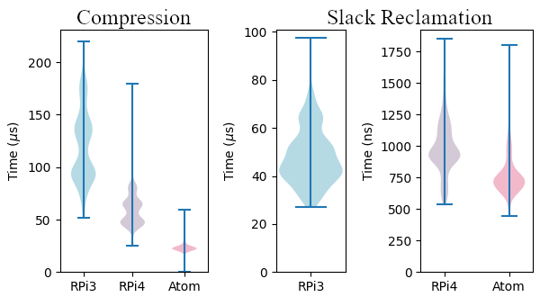
Overheads

Slide 27
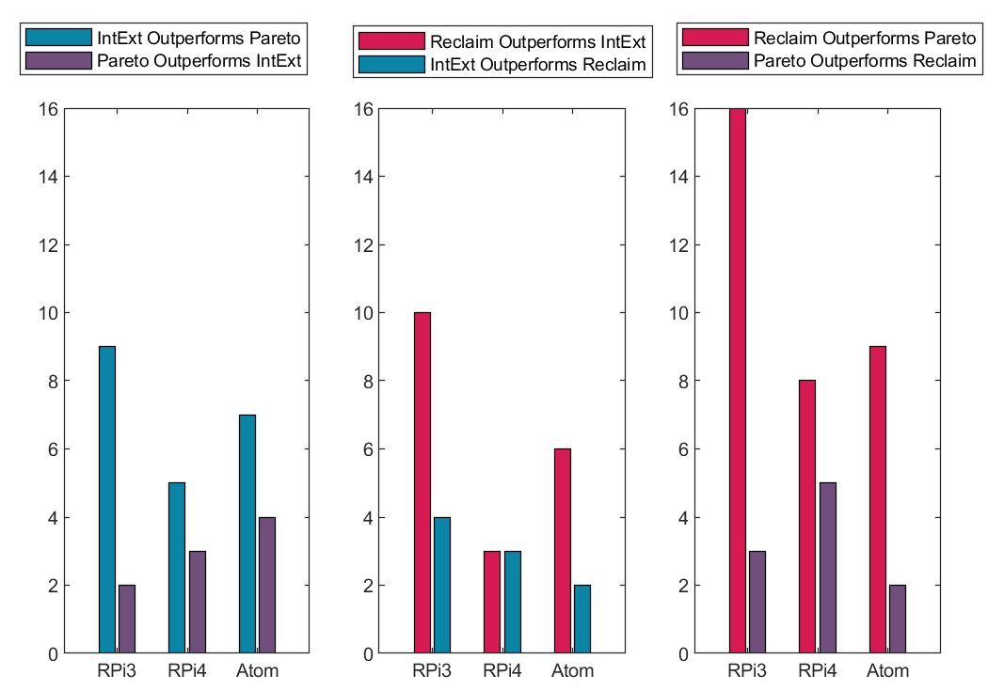
Comparisons of
Interpolation, Extrapolation, and Slack Reclamation

Slide 28
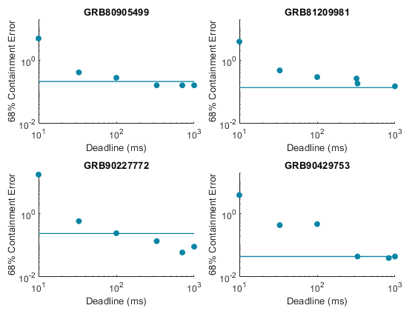
APT Compressed Localization Results: RPi3

Slide 29
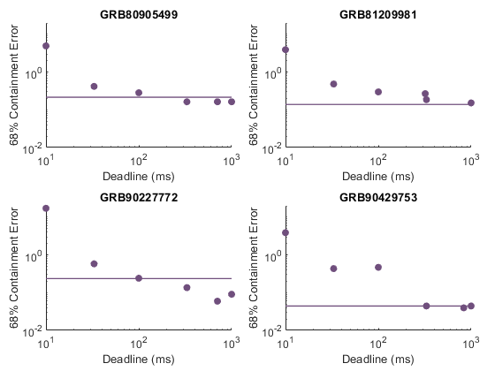
APT Compressed Localization Results: RPi4

Slide 30
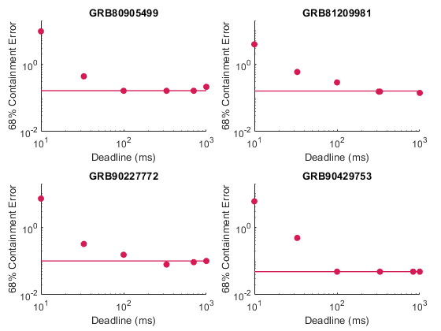
APT Compressed Localization Results: Atom

Slide 31
Results and Conclusions
Simulated 4 known short, bright GRBs
Worst-case response time on flight computer:
200ms – 1.3s
Imposed 33ms deadline:
Localized to within 1 degree!
Offline parameter and loss characterization allows for fast online workload adaptation for GRB localization!
This approach extends to other dynamic fork-join workloads with loss functions that are difficult to characterize in closed form
Other tricks discussed in paper, e.g., reducing pessimism through slack reclamation
Future work: federated scheduling of general DAG tasks.
  Response times can be characterized given core allocation, but interpolation/extrapolation may be difficult.
  What if core allocations are not fixed a priori?

