Slide 1

Localization of Gamma-ray Bursts in a Balloon-Borne Telescope
Ye Htet, Marion Sudvarg, Jeremy Buhler, Roger D. Chamberlain, James H. Buckley
Funded by: NASA award 80NSSC21K1741

Slide 2
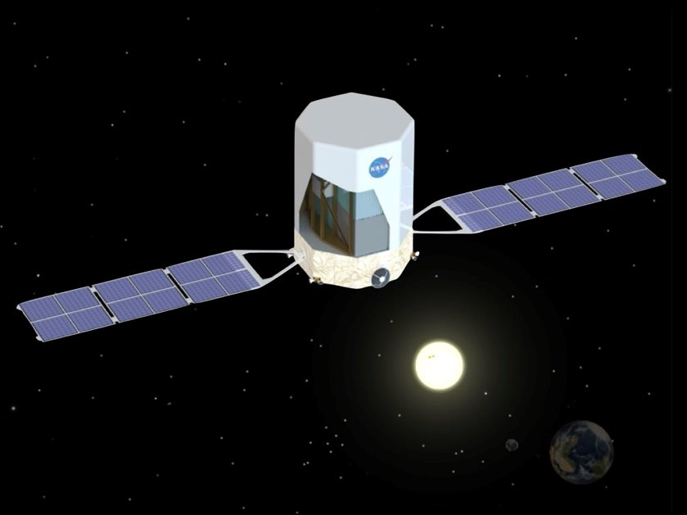
APT: Advanced Particle-astrophysics Telescope
Why APT?
Determining the nature of dark matter
Understanding the physics of neutron-star mergers

Slide 3
ADAPT
Antarctic Demonstrator for the Advanced Particle-Astrophysics Telescope (ADAPT)
Balloon demonstration of the components and detectors (smaller)
Launching in late 2025

Slide 4
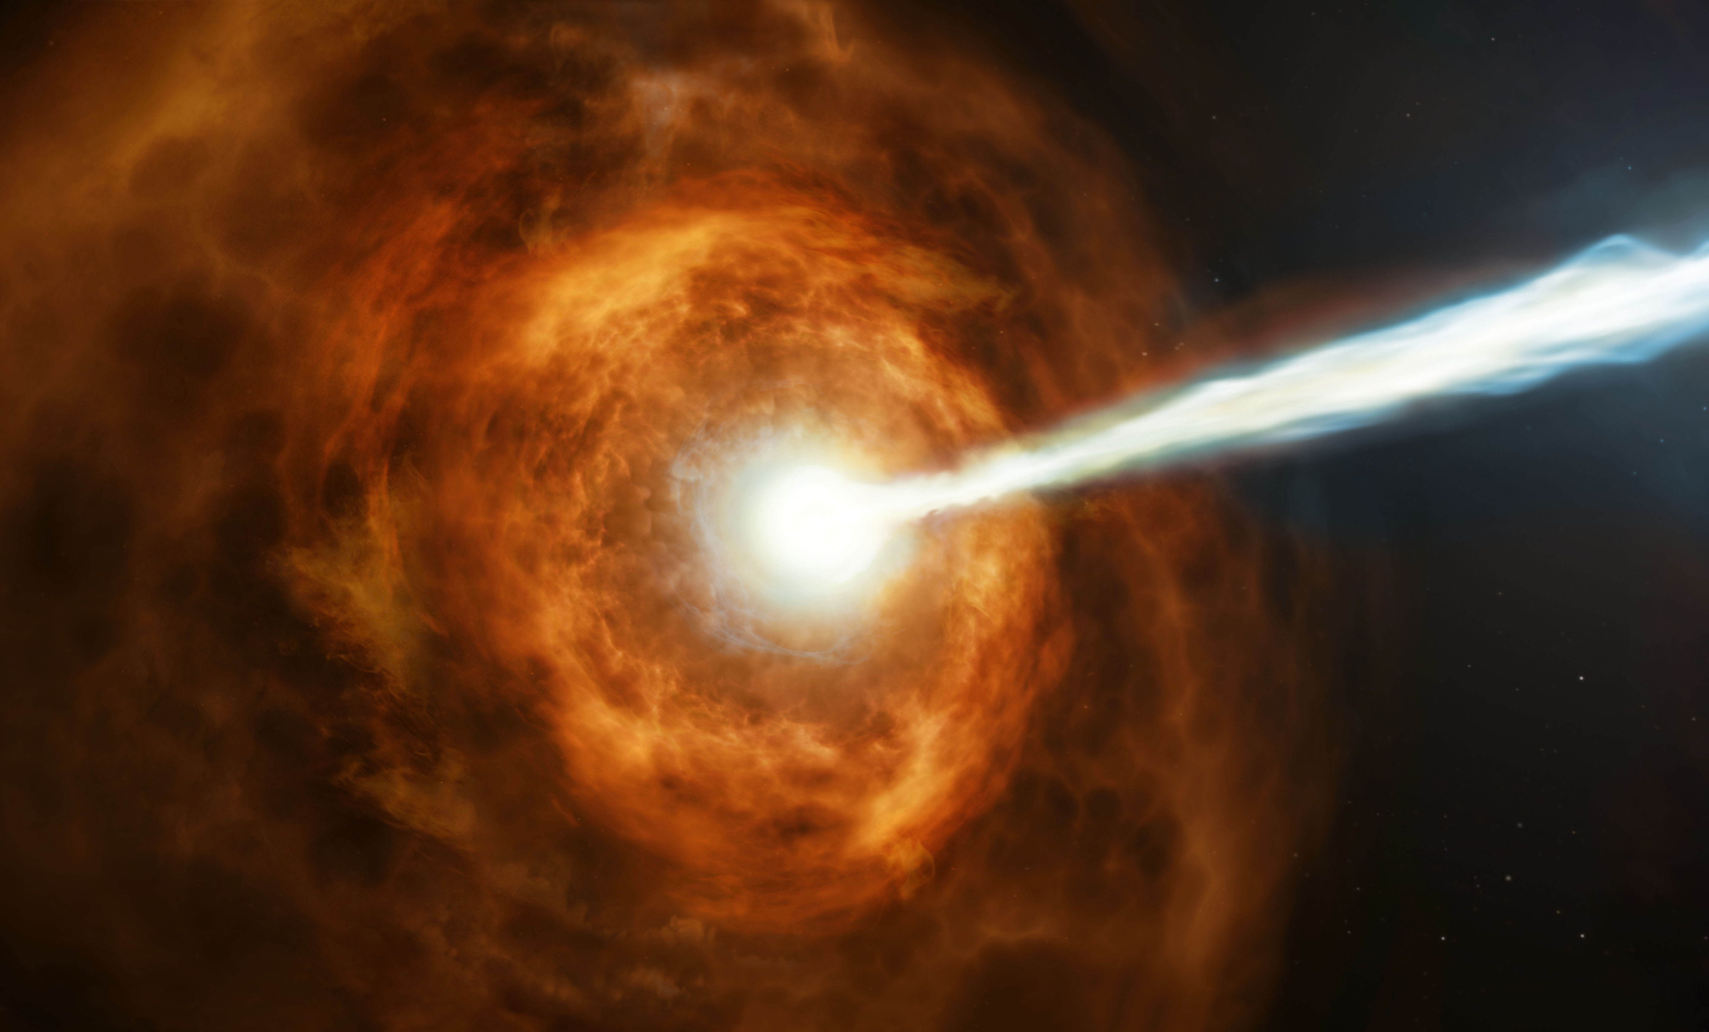
Gamma-Ray Burst (GRB) Localization
Determining the source of Gamma Ray Bursts
Typically last a few minutes (Long GRBs) but there are many <2 seconds (Short GRBs)
Signal other telescopes to point towards the source (Multi-messenger)
Credit:ESA/Hubble, M. Kornmesser

Slide 5
Gamma-Ray Burst (GRB) Localization
Motivation:
Other telescopes have narrow field of view (FOV)
Omnidirectional detectors (GW/Neutrino detectors) are computationally intensive
Every small degree matters!
Goal:
We want to localize the source to within 1 degree of arc in the sky

Slide 6
Gamma-Ray Burst (GRB) Localization
Motivation:
Short GRBs last <2s
Other telescopes take some time to move and/or point
Goal:
We want the computation to be fast (sub-second) on a low power platform (limited resources)

Slide 7
Gamma-Ray Burst (GRB) Localization
Multi-messenger astrophysics
Gamma-ray detection can achieve
  better localization accuracy
  in shorter time using lower computation power
Post-detection impacts HPC taking place in other detectors
  E.g. Pattern matching (resource intensive)

Slide 8
Contributions
Impact of Uncertainty in Spatial and Energy Measurements
Impact of other types of noise
Techniques to mitigate their effects

Slide 9
Outline
Brief overview of the GRB localization pipeline and sources of noise and uncertainty
Using additional detector hardware to improve localization accuracy
Mitigating the impact of Atmospheric Particle Background
Localization results at varying incident angles of a GRB

Slide 10
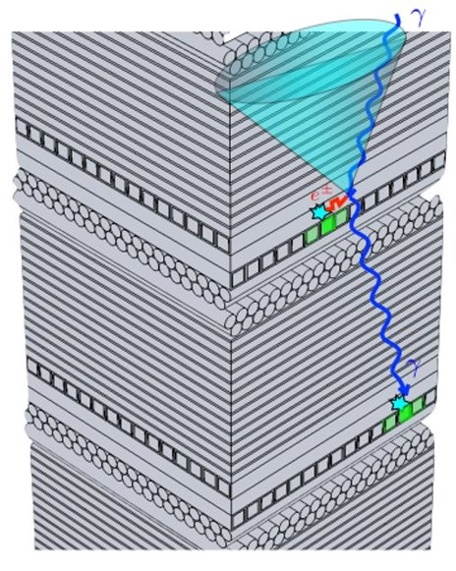
Pipeline
Detection
Reconstruction
Localization
Crystal emits light when gamma-ray (event) scatters within it
We measure positions and energies of the interactions (hits)
Result: [(r_{i}=(x_{i},y_{i},z_{i}) , E_{i})]
Crystal layer
Fibers

Slide 11
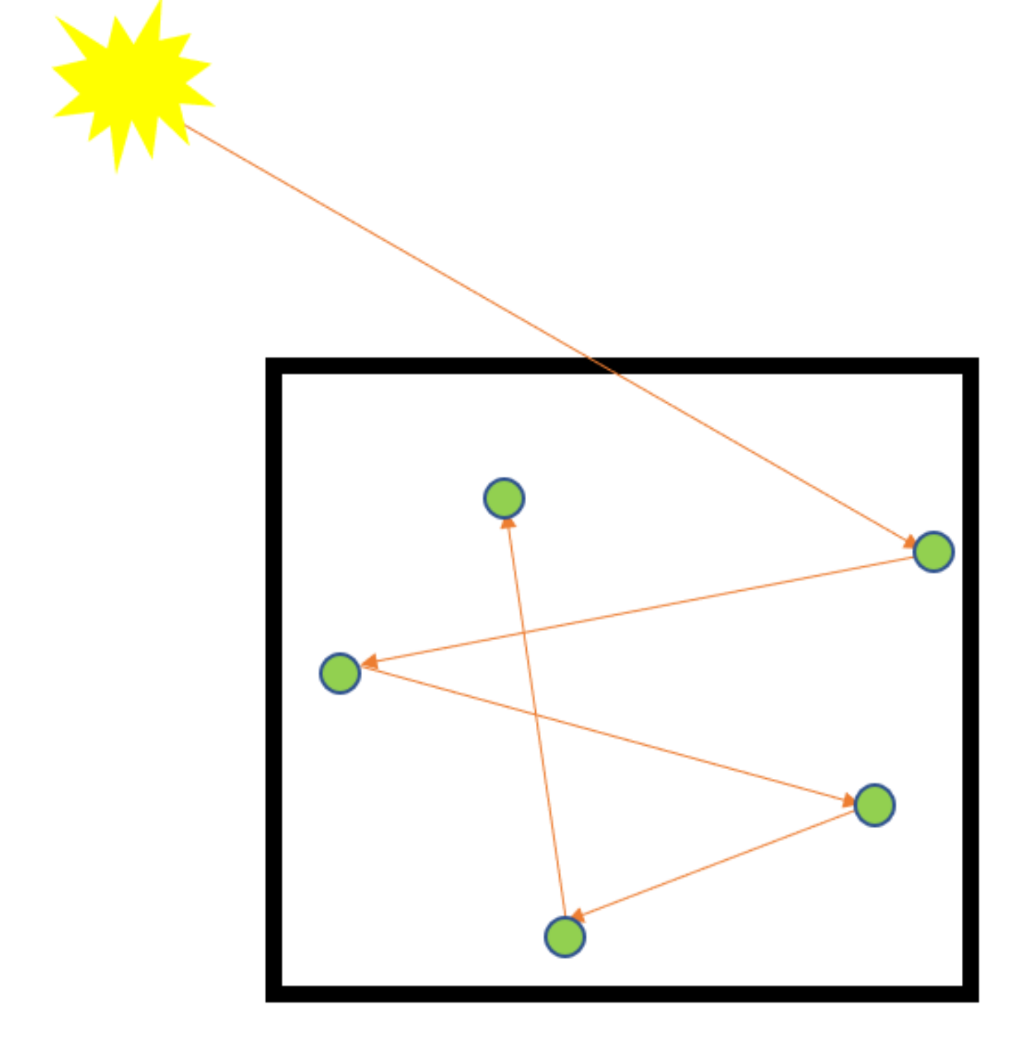

Pipeline
Detection
Reconstruction
Localization
If we know first two hits, Compton's law will tell us the direction of the source
But, hits appear simultaneous
Algorithm infers hit order
Reconstruction Result: A circle that is a prediction for source of the gamma-ray
s
c
θ

Slide 12
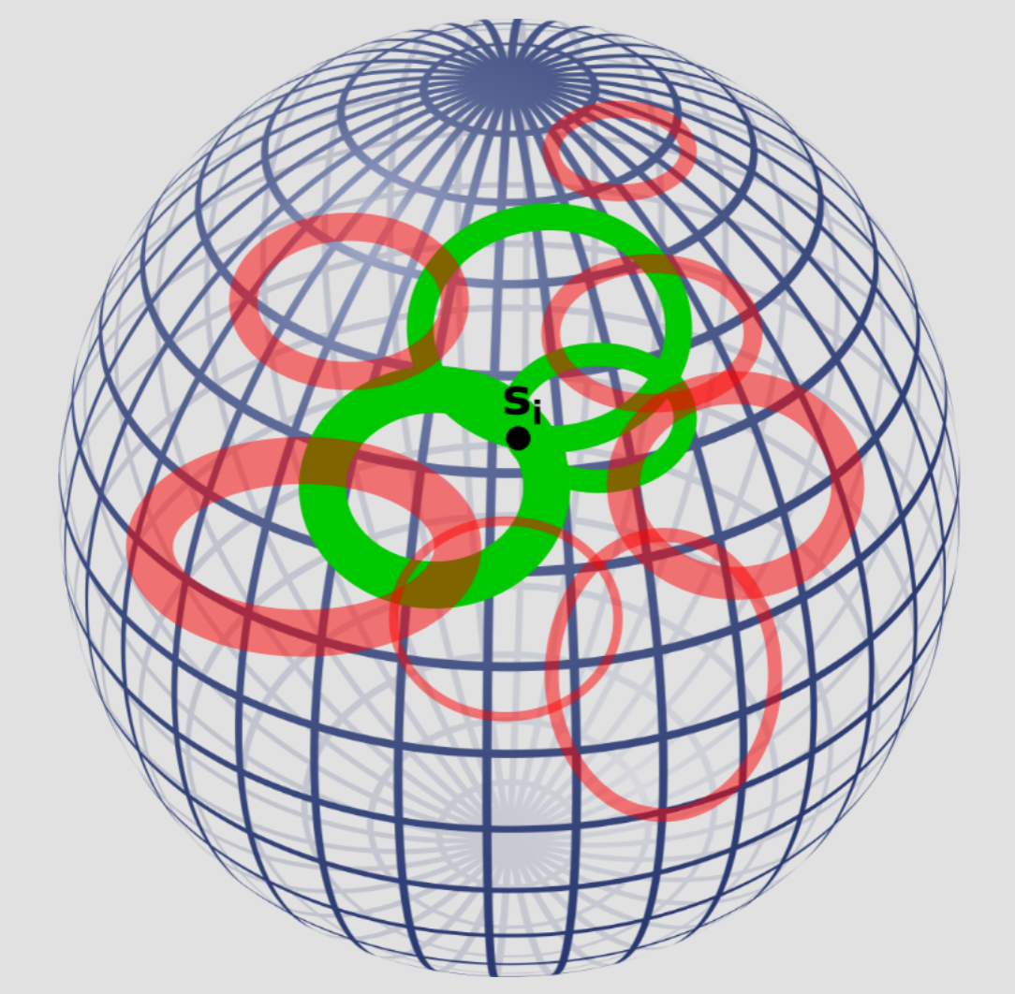
Pipeline
Detection
Reconstruction
Localization
Intersect Compton rings from hundreds or thousands of events to infer a common source direction for the GRB.
GRB Source
s
Angular Error
Detector
v

Slide 13
Noise and Uncertainty
Physical phenomena
  Gamma-ray leaving the detector
  Non-Compton phenomena
  Atmospheric particle background
  Incident angle of the GRB
Detector Noise (Sudvarg 2023*)
  Electronic Noise
  Detection efficiencies
Leads to missing/extra hits, incorrect energy measurements
*Marion Sudvarg, et al. “Front-End Computational Modeling and Design for the Antarctic Demonstrator for the Advanced Particle-astrophysics Telescope.” In Proc. of 38th International Cosmic Ray Conference – PoS(ICRC2023), volume 444, pages 764:1–764:9, July 2023.

Slide 14
Experiments
GT + "Physics" Noise
GEANT – A physics simulator (CERN)
  Physical Phenomena Noise
Gives us extra information about the events (Ground truth(GT) hit energies and positions)
We implement a device simulation ("Measured" values of the hits (r_{i}, E_{i}))
  Detector Noise
Physics Simulation
(GEANT)
Detector Simulation
Complete Noise: (r_{i}, E_{i})

Slide 15
Using additional detector hardware to improve localization accuracy

Slide 16
Energy vs Spatial Measurements
Input: [(r_{i}, E_{i})]
Goal: Where is the weak link?
Experiment: Use ground truth information from the physics simulator (GEANT)

Slide 17
Energy vs Spatial Measurements
Experiment: Swapping Ground Truth values
Data | Energies | Positions (Spatial)
1 | Measured | Measured
2 | Measured | Ground Truth
3 | Ground Truth | Measured
4 | Ground Truth | Ground Truth

Slide 18
Energy vs Spatial Measurements
Approximate a typical GRB
Sampling 18700 events
  1 MeV/cm² fluence (GRB energy density)
1000 trials
  68/95% containments
10 meta trials
  95% confidence intervals
GRB Source
s
Angular Error
Detector
v
P% Containment: P% of the trials are less(better) than that value

Slide 19
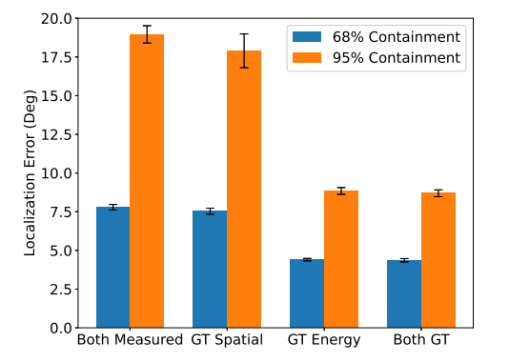
Energy vs Spatial Measurements
Approximate a typical GRB
Sampling 18700 events
  1 MeV/cm² fluence (GRB energy density)
1000 trials
  68/95% containments
10 meta trials
  95% confidence intervals
GT = Ground Truth

Slide 20
Edge Detectors & Tail Counters
Edge Detector
At the side of the device layers
Provides a better energy estimate of each hit
Tail Counters
At the bottom the device
Provide a better total energy estimate of the whole gamma-ray

Slide 21
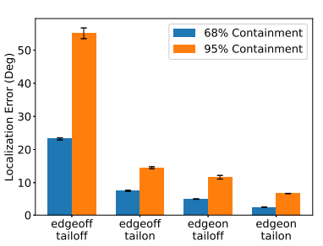
Edge Detectors & Tail Counters
Approximate a typical GRB
Sampling 18700 events
  1 MeV/cm² fluence (GRB energy density)
1000 trials
  68/95% containments
10 meta trials
  95% confidence intervals

Slide 22
Mitigating the impact of Atmospheric Particle Background

Slide 23
Atmospheric Particle Background
ADAPT's balloon instrument will be flying in the Earth's atmosphere
Atmospheric background particles appears as extraneous events in our computational pipeline
May be reconstructed to different directions other than the source

Slide 24
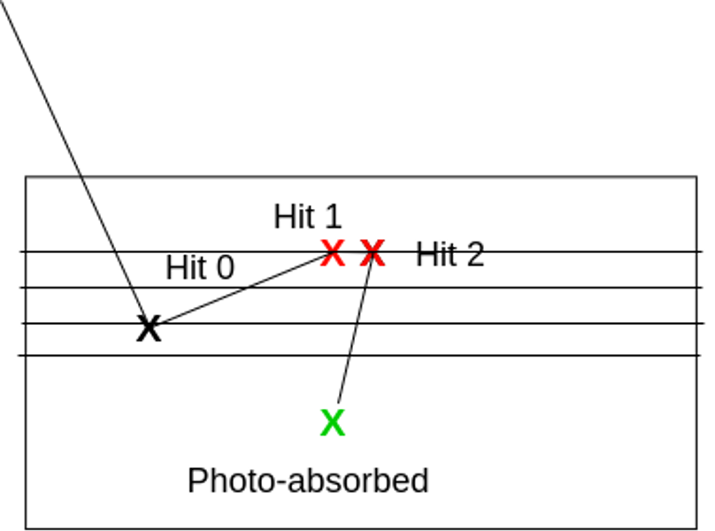
Two Strategies for Removing Background
Remove events in which two hits occur in the same layer
Rejects reconstructed events for which the Compton ring lies entirely below the horizontal

Slide 25
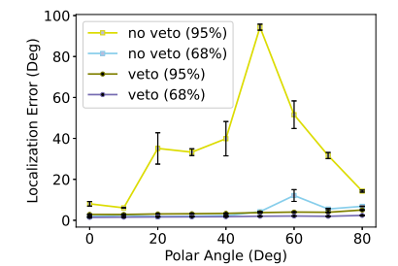
Atmospheric Particle Background

Slide 26
Localization results at varying incident angles of a GRB

Slide 27
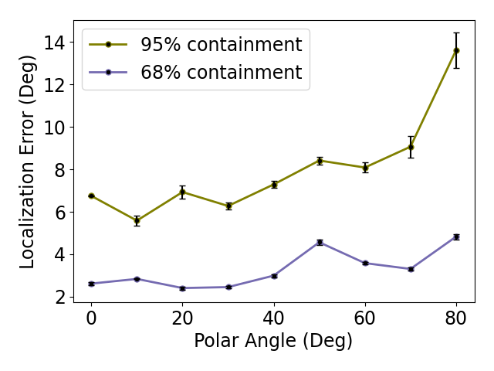
Final Localization Accuracy
The error broadly increases with increasing angle
is within 2-3 degrees of accuracy for ≤ 40° incident angles

Slide 28
Final Localization Accuracy
Achieved significant improvement in accuracy
Not <1 degree?
  We are using a smaller detector for ADAPT
  APT will have 45 times larger area – significant improvement in accuracy

Slide 29
Conclusion & Future Direction
GRB Localization for ADAPT
  is within 2-3 degrees of accuracy for ≤ 40° incident angles
  68% of the time
  on the smaller detector,
  and in the presence of background radiation in the upper atmosphere
Extending the work to full APT
Considering additional sources of uncertainty
  Bandwidth of electronics reducing the effective number of photons available

