Slide 1
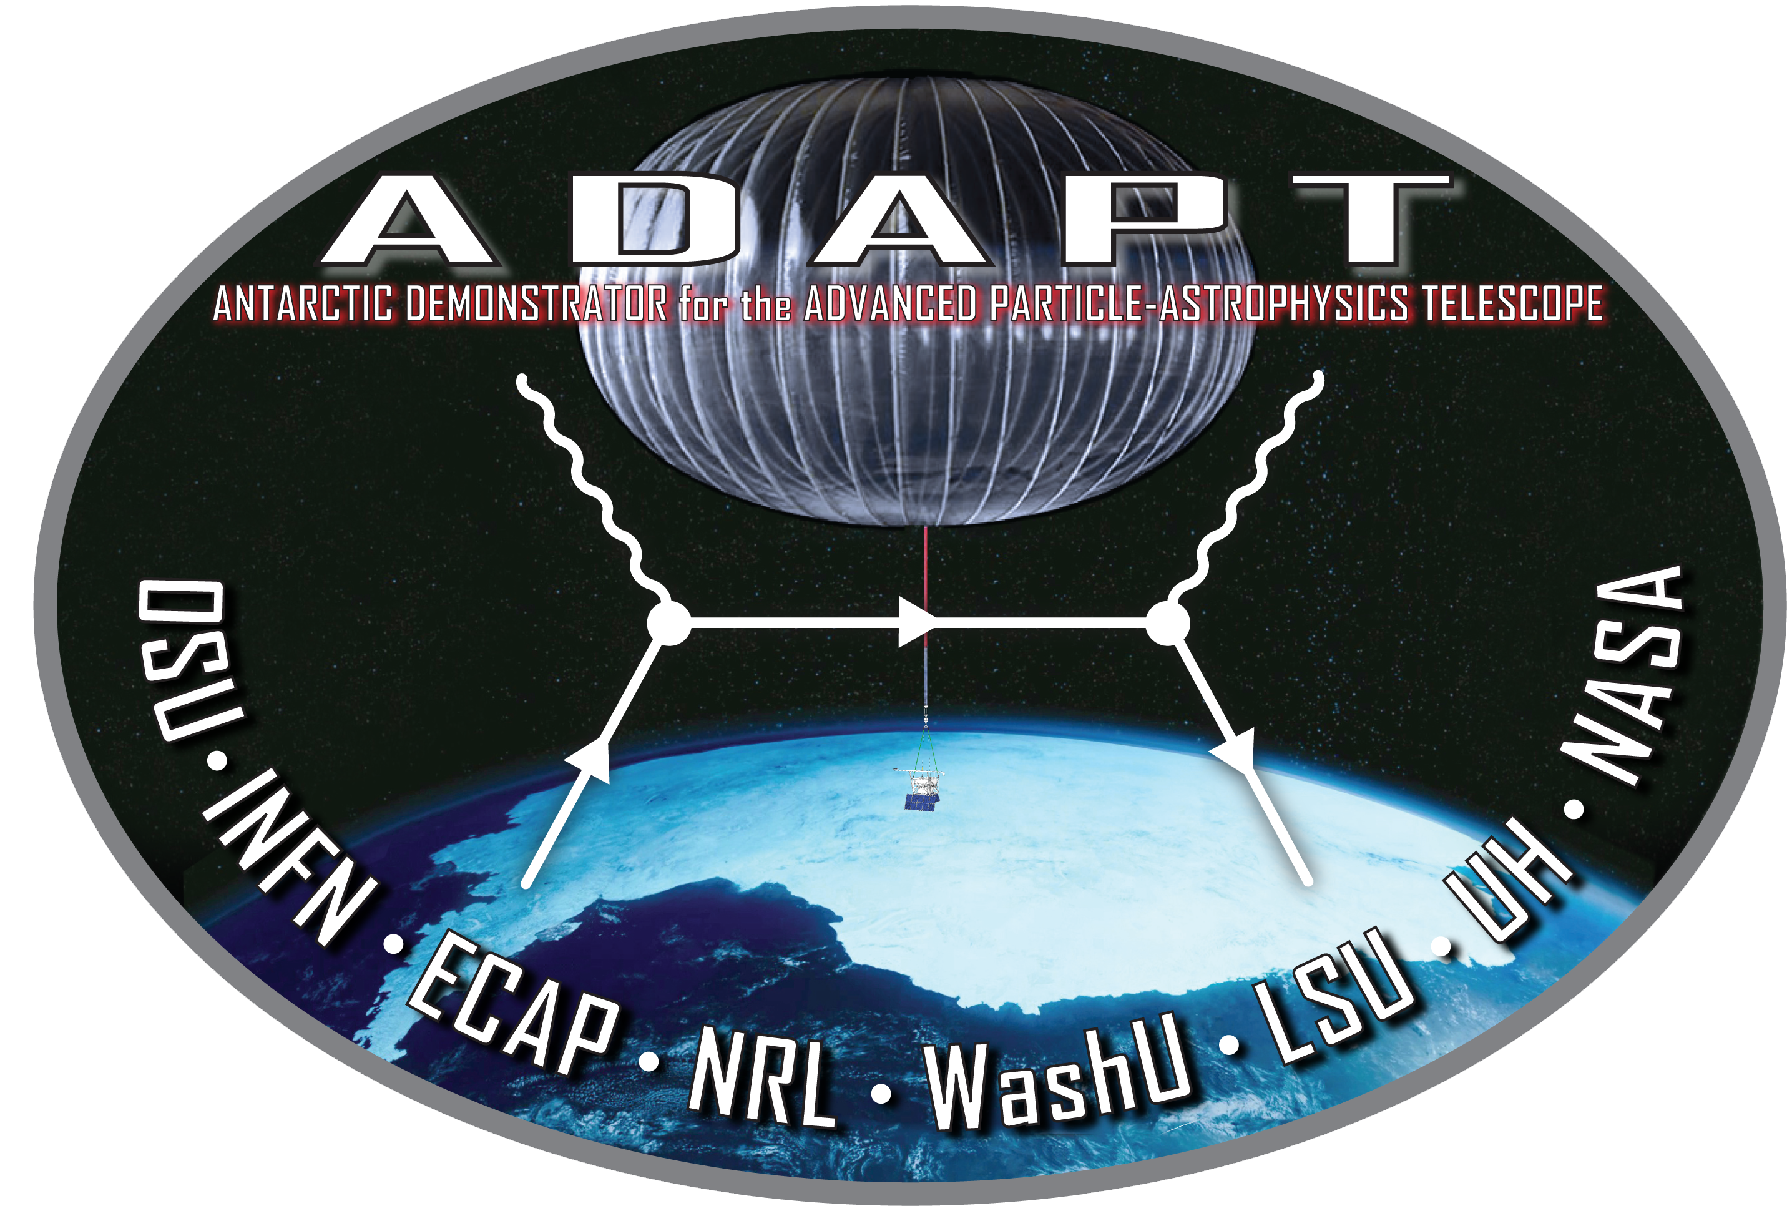
Machine Learning Aboard the ADAPT
Gamma-Ray Telescope
By: Ye Htet (Presenter), Marion Sudvarg, Andrew Butzel, Jeremy D. Buhler, Roger D. Chamberlain, and James H. Buckley
This work was supported by NASA award 80NSSC21K1741, an NSF REU site award and by Washington University seed grant CC0001285 (PJ000030737)

Slide 2
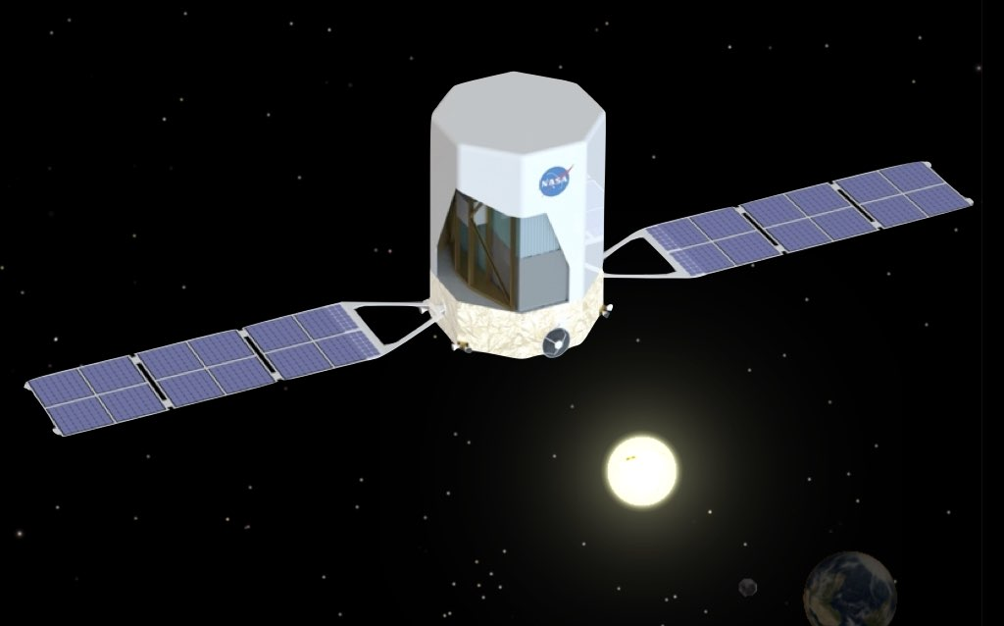
Introduction
APT: Advanced Particle-astrophysics Telescope
Determining the nature of dark matter
Understanding energetic transient events in the deep universe

Slide 3
Introduction
ADAPT: Antarctic Demonstrator for APT
Balloon demonstration of the components and detectors (smaller)
Launching in late 2025

Slide 4
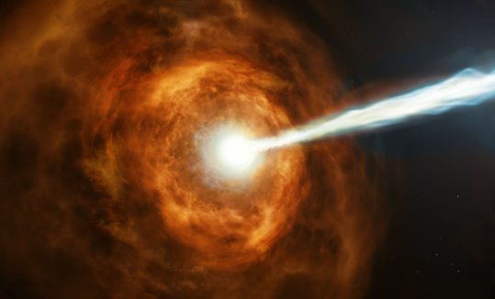
Introduction
Gamma-Ray Burst (GRB) Localization
Determining the source of Gamma Ray Bursts
Typically last a few minutes (Long GRBs) but there are many <2 seconds (Short GRBs)
Signal other telescopes to point towards the source (Multi-messenger)
GRB 190114C Caption: New observations from NASA's Hubble Space Telescope have investigated the nature of the powerful gamma-ray burst GRB 190114C by studying its environment. Credits: NASA, ESA, and M. Kornmesser

Slide 5
Motivation
ML and Multi-messenger astrophysics
Multiple instruments over different wavelengths for fast follow up analysis.
Many instruments perform omnidirectional event detection but use compute-intensive pattern-matching searches.
Must run on large clusters.

Slide 6
Motivation
ML and Multi-messenger astrophysics
Deep Learning approach has been promising for processing large data efficiently and accurately.
In gravitational-wave astronomy, neural networks detect transient events
  can process months of data from the LIGO detector within 50 second.
Still deployed on ground-based computers.

Slide 7
Motivation
Our Goal
Pipeline that runs onboard the telescope, for fast follow up analysis.
Non-machine learning approach currently works for APT (sub-degree error) but for ADAPT(balloon) suffers from additional noise and smaller component.
New machine learning approach that can work in conjunction with the traditional approach that improves accuracy while within timing deadline.

Slide 8
Contribution
Machine Learning Approach
Apply two neural networks (Multi-Layer Perceptrons) to the GRB localization problem
  Background/signal identification (Classification)
  Uncertainty estimation (Regression)
Quantization and FPGA deployment

Slide 9
Outline
Background
  GRB localization pipeline
Neural Networks
Localization Results
  Accuracy
  Speed
Quantization, FPGA

Slide 10
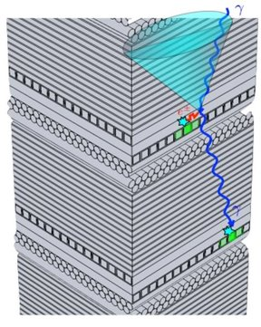
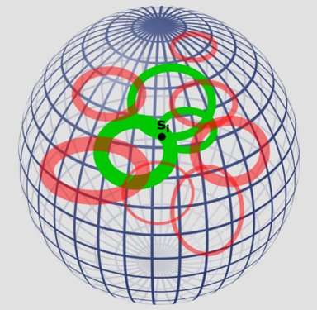
GRB Localization Pipeline
MeV range Gamma-ray Telescopes (Compton)

Slide 11
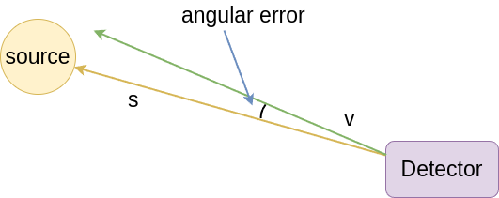
GRB Localization Pipeline
MeV range Gamma-ray Telescopes (Compton)
ŝ

Slide 12
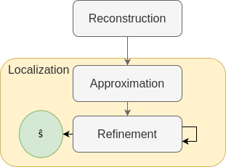
GRB Localization Pipeline
Reconstruction
Localization
  Approximation
  Iterative Refinement

Slide 13
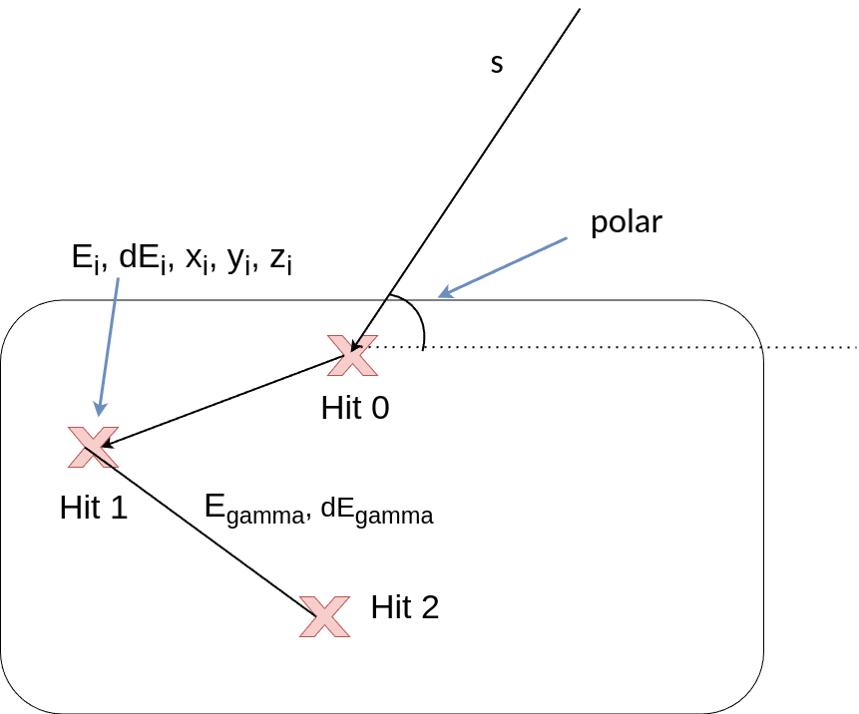
GRB Localization Pipeline
Reconstruction
Determine the first two hits and the energy of the gamma-ray

Slide 14
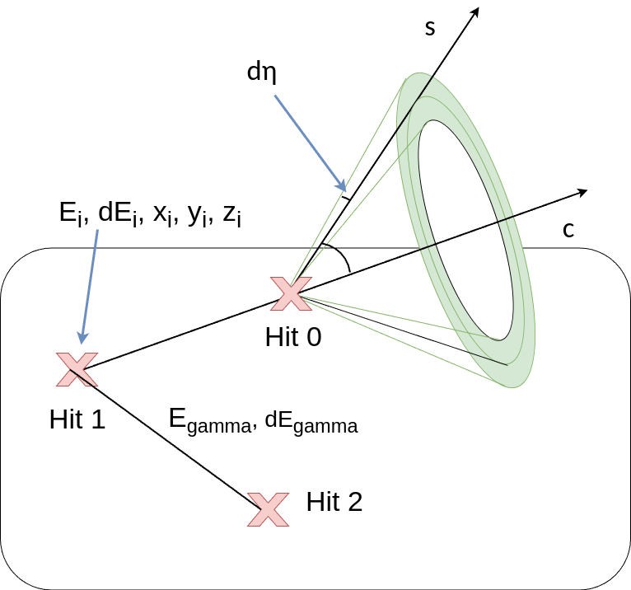
GRB Localization Pipeline
Reconstruction
Determine the first two hits and the energy of the gamma-ray
Reconstruction Result: A Compton ring that is a prediction for source of the gamma-ray
η

Slide 15
GRB Localization Pipeline
Localization
Approximation
  Sample some rings and get initial source estimate of maximum likelihood given rings
  Use dEta as weights
Refinement
  Select rings close to the initial estimate
  Iteratively apply least squares
  Use dEta as weights

Slide 16
Machine Learning: Neural Networks
Two challenges for ADAPT
Earth's atmospheric particle background

Slide 17
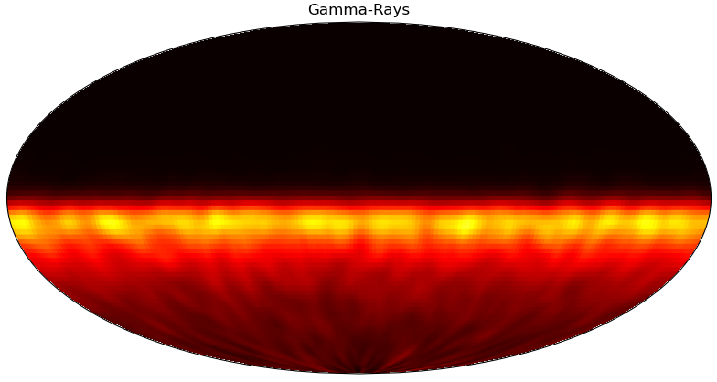
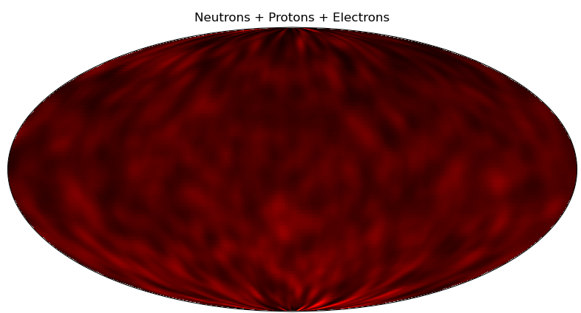
Machine Learning: Neural Networks
Two challenges for ADAPT
Earth's atmospheric particle background
Background Gamma-rays
Background Particles
(Neutrons + Electrons + Protons)

Slide 18
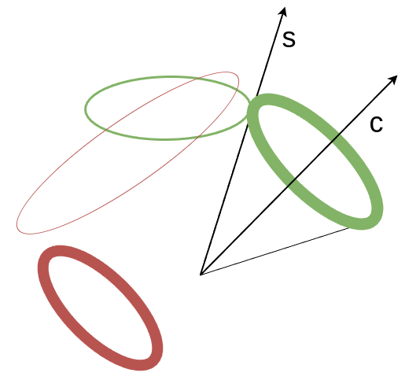
Machine Learning: Neural Networks
Two challenges for ADAPT
Earth's atmospheric particle background
Large quantities of background rings generated from reconstruction
2-3x as many as “source” rings

Slide 19
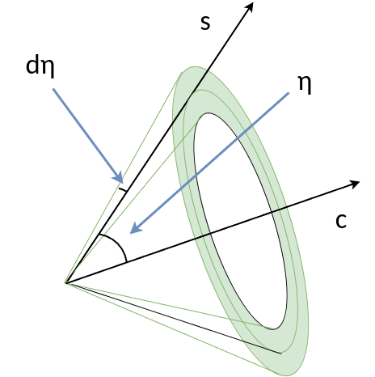
Machine Learning: Neural Networks
Two challenges for ADAPT
Earth's atmospheric particle background
Better quantification of uncertainty (dη)
  Traditionally, by propagation*
  Used as weights in localization
*Y. Htet, M. Sudvarg, J. D. Buhler, R. D. Chamberlain, and J. H. Buckley, “Localization of gamma-ray bursts in a balloon-borne telescope,” in Proc. Wkshps. Int’l Conf. High Performance Computing, Network, Storage, and Analysis (SC-W), Nov. 2023, pp. 395–398.
Y. Htet et al., “Prompt and accurate GRB source localization aboard the Advanced Particle Astrophysics Telescope (APT) and its Antarctic Demonstrator (ADAPT),” in Proc. 38th Int’l Cosmic Ray Conf., vol.444, Jul. 2023, pp. 956:1–956:9

Slide 20
Machine Learning: Neural Networks
Two challenges for ADAPT
Earth's atmospheric particle background
  Background filter network (Classification)
Better quantification of uncertainty (dη)
  dEta network (Regression)

Slide 21
Neural Networks
Model Usage
Extend our original pipeline
Still use the same two stages

Slide 22
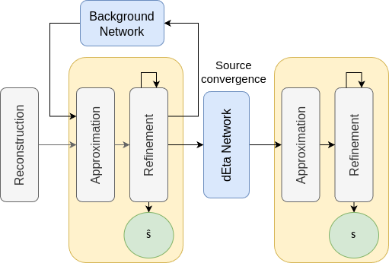
Neural Networks
Model Usage
Remove background rings using Background network
Refine rings with dEta network
Once final localization stage

Slide 23
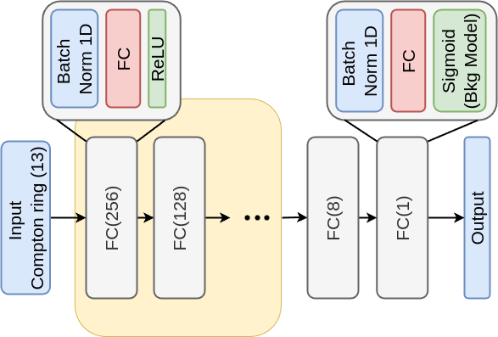
Neural Networks
Model Architecture
Inspired by (Takashima, 2022)*
Made of blocks
Hyperparameter tuning
  Width
  Depth
  Shape
*S. Takashima, H. Odaka, H. Yoneda, Y. Ichinohe et al., “Event reconstruction of compton telescopes using a multi-task neural network,” Nucl.
Instrum. Methods Phys. Res. A, vol. 1038, p. 166897, 2022.

Slide 24
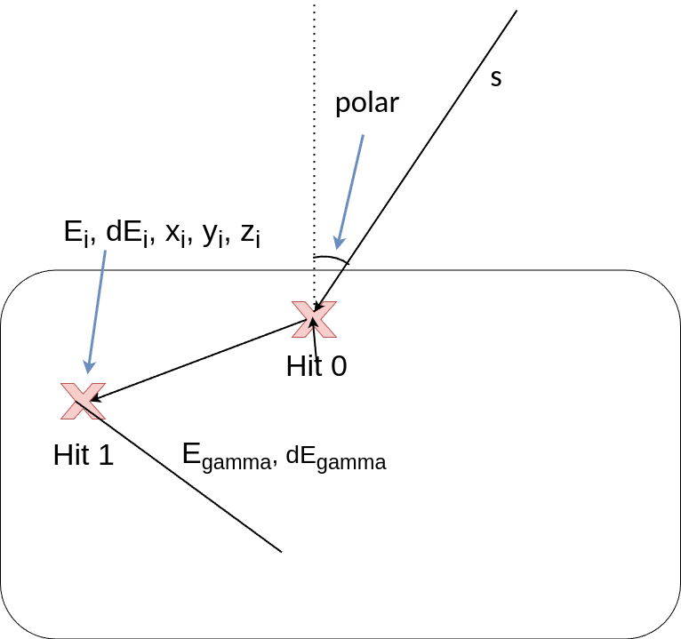
Neural Networks
Input Features
13 Features
First 2 hits (Hit 0, Hit 1) [5 x 2]
Gamma-ray Energy [2]
Estimate source vec*[1]

Slide 25
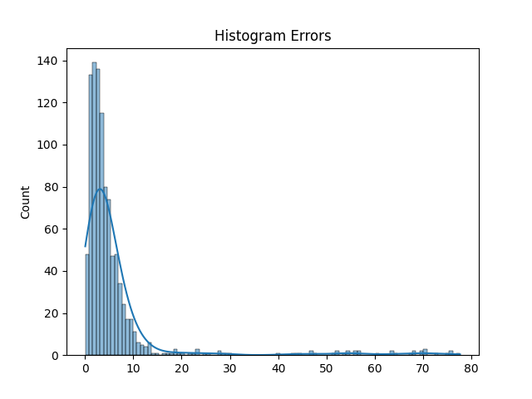
Experiments
68%
95%
Setup
Approximate a typical GRB using physics simulator (GEANT4)
Sampling 44600 gamma-rays
  1 MeV/cm² fluence (GRB energy density)
1000 trials
  68/95% containments
10 meta trials
  95% confidence intervals

Slide 26
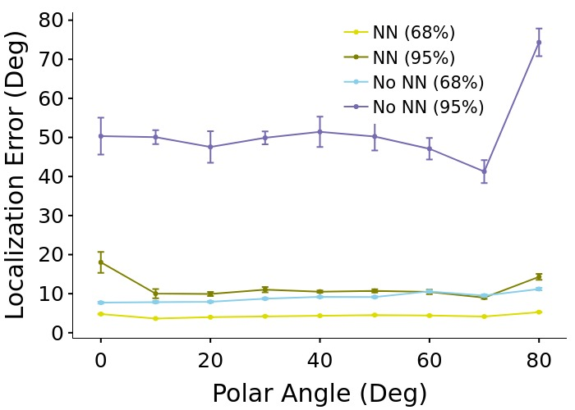
Experiments
Localization Accuracy
Approximate a typical GRB using physics simulator (GEANT4)
Sampling 44600 gamma-rays
  1 MeV/cm² fluence (GRB energy density)
1000 trials
  68/95% containments
10 meta trials
  95% confidence intervals

Slide 27
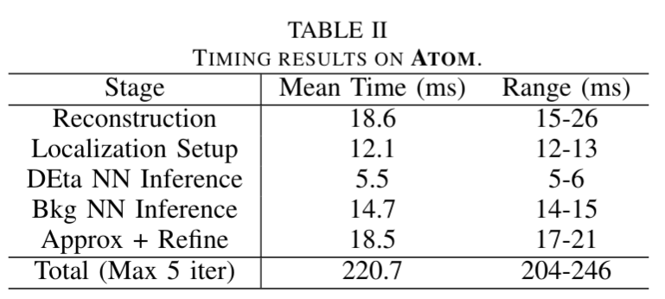
Experiments
Localization Speed
Intel Atom CPU
  4 cores
  8GB RAM
  ~ 200 ms
Mean of 300 trials

Slide 28
Quantization
Motivation
Can we further improve our latency?
Many model compression techniques:
  Pruning
  Knowledge Distillation
Quantization -> can be optimized for low-bit operators in hardware (size, speed, power)

Slide 29
Experiments
Quantization
PyTorch's Eager Mode Quantization Aware Training (QAT)
'x86' default configuration
FP32 to INT8
68% containment is similar, but the 95% containment got worse

Slide 30
Experiments
FPGA using HLS
High Level Synthesis tool (Vitis HLS)
Pipelined execution of layers
For 597 rings (1 MeV/cm²) ~4 ms compared to 14-15 ms on the Atom
1.75× the throughput of FP32 on the FPGA

Slide 31
Conclusion
Neural network models improves resilience to background radiation and measurement uncertainty, under low-resource, real-time computation.
Preliminary evidence to support further resource reduction through quantization and acceleration in FPGA logic.
ADAPT, with ML, is expected to localize a moderately bright, short-duration GRB in under a second with a typical localization accuracy of six degrees (6°).

Slide 32
Future Work
Consideration of additional sources of error, such as multiple events arriving simultaneously
More quantization strategies, including different configs and other libraries outside of PyTorch.
Finally, we will study the impact of our models on the full APT instrument which could allow localization of even dim (< 0.1 MeV/cm²) GRBs to within a degree or less.

Slide 33
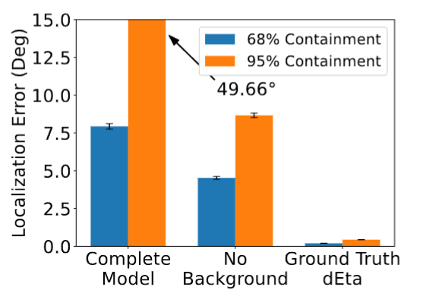
Machine Learning: Neural Networks
Two challenges
Earth's atmospheric particle background
Better quantification of uncertainty (dη)
  Used as weighting in localization

Slide 34
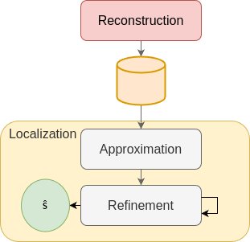
Background
Gamma-Ray Localization Pipeline
Two stages
Reconstruction:
  Per gamma-ray
Localization
  Per batch of gamma-rays

Slide 35
Gamma-Ray Localization Pipeline
Reconstruction
Crystal emits light when gamma-ray (event) scatters within it.
We measure positions and energies of the interactions (hits).
Result: [(r_{i}=(x_{i},y_{i},z_{i}) , E_{i})].
In general: Compton Telescope
Crystal Layer
Fibers

Slide 36
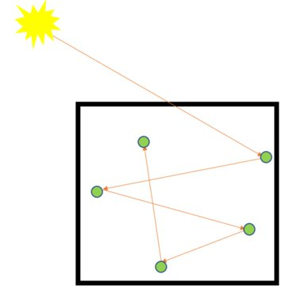

Gamma-Ray Localization Pipeline
Reconstruction
Hits appear simultaneous
Determine the first two hits and the energy
Reconstruction Result: A Compton's ring that is a prediction for source of the gamma-ray

Slide 37
Gamma-Ray Localization Pipeline
Reconstruction
If we know first two hits, Compton's law will tell us the direction of the source
But hits appear simultaneous
Algorithm infers hit order
Reconstruction Result: A Compton's ring that is a prediction for source of the gamma-ray

Slide 38
Neural Networks
Model Training
Hyperparameter tuning using random grid search

Slide 39
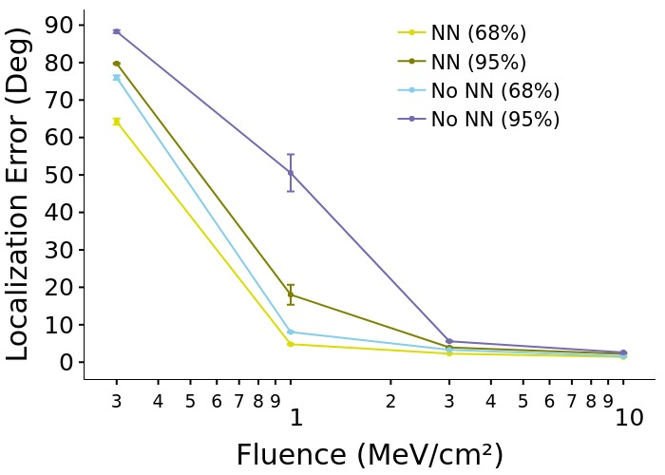
Experiments
Localization Accuracy
Varying fluences
1000 trials
  68/95% containments
10 meta trials
  95% confidence intervals

Slide 40
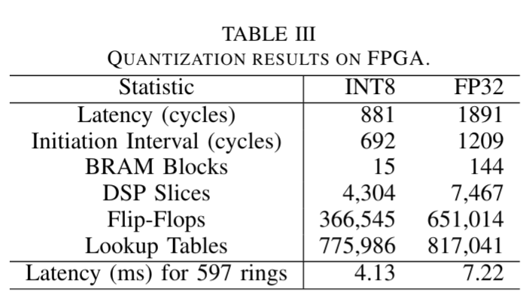
Experiments
FPGA using HLS
High Level Synthesis tool (Vitis HLS)
Pipelined execution of layers
For 597 rings (1 MeV/cm2) 4.13 ms
(compared to 22-58 ms on the RPi 3B+ and 14-15 ms on the Atom), and achieves 1.75× the throughput of FP32

Slide 41
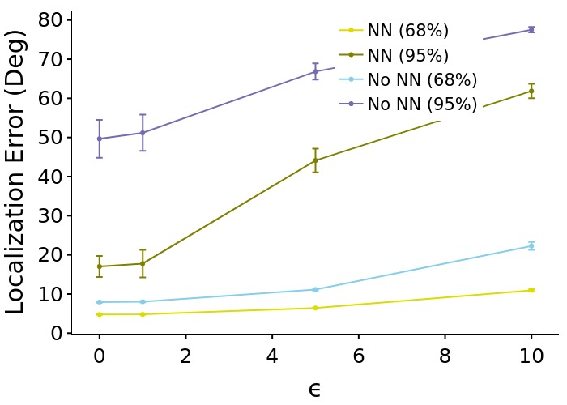
Experiments
Robustness
If we know first two hits, Compton's law will tell us the direction of the source
But, hits appear simultaneous
Algorithm infers hit order
Reconstruction Result: A circle that is a prediction for source of the gamma-ray

Slide 42
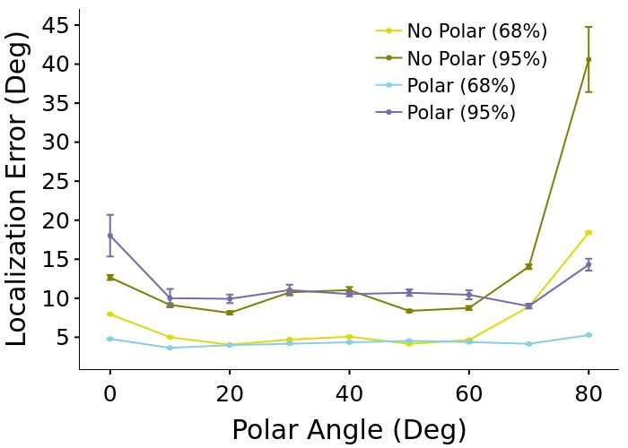
Experiments
Polar vs Nopolar
If we know first two hits, Compton's law will tell us the direction of the source
But, hits appear simultaneous
Algorithm infers hit order
Reconstruction Result: A circle that is a prediction for source of the gamma-ray

Slide 43
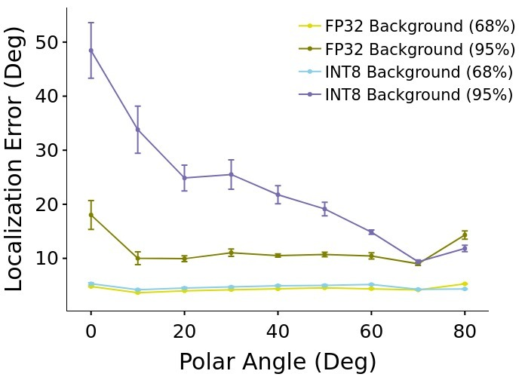
Experiments
Quantization
PyTorch's Eager Mode Quantization Aware Training (QAT)
'x86' default configuration
FP32 to INT8
68% containment is similar, but the 95% containment got worse

